Slide 1
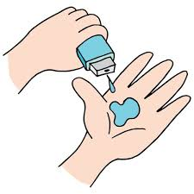
SkillBuild-Jahir-Team1
Final Project

Slide 2
Project Title
SMART TOURISM GUIDE
Done by:
Hima Sagar Janagama
Karre Yaswanth
G Sujan Kumar Reddy
Annapareddy Navya Sri
Purna Manikanta

Slide 3
agenda
project title
agenda
Problem Statement
Project Overview
who are the end users
your solution and its value proposition
The wow in your solution
Modelling
Results
Meet our team
credits

Slide 4

PROBLEM STATEMENT
A Web application to manage the traveling activities like city tours and hotels for a traveller
A Website that has has

Slide 5

PROJECT OVERVIEW
“Smart Tourism Guide” is tourism website . The main purpose of “Smart Tourism Guide” is to provide convenient way for customer to book hotels, to visit tourist places, adventurous places and many historical places throughout India.
In the present running tourism websites, there are only restricted to some places only like Telangana tourism for only Telangana state and Gujarat Tourism for Gujarat state.
And these websites show only tourist spots where as in our website along with tourist spots, we make this website useful for all sectors of people. We have included separate sections for Divine Locations, Historical monuments, Wildlife Parks, Popular shopping Locations and more.

Slide 6

WHO ARE THE END USERS?
Consumers are the end-users who buy the travel products or services. The main types of consumers are business travelers, leisure tourists (either domestic or international) and people who are visiting friends or relatives.
People will look for all sorts of information about their travel destination.
Tourists will be eager to learn more about local tourist attractions in destination. They will be interested to know what they can see and experience when they visit the place.
This website is useful for all kinds of people as it was designed in a way such that all sort of people can separately find their destinations.

Slide 7

YOUR SOLUTION AND ITS VALUE PROPOSITION
Provides insights of different locations.
No need of visiting each and every state tourism
Users can easily understand about different locations.
Integrated Platform ( contains Divine locations, Popular Places, Cultures etc).
User friendly.

Slide 8

THE WOW IN YOUR SOLUTION
To satisfy the user we not only classified the destinations by their states, but also segregated them by their genre i.e., The Divine Locations, Hills/valleys and Locations famous for Adventures etc.,
We also displayed the beauty of the respective places to make it more attractive.
To understand the places even better we also included the cultural section.
There is no necessity of visiting each and every state tourism website as we included all the things in our website itself.

Slide 9
MODELLING
*Home
enter the matter
*About
enter the metter
*Divine Locations
Many of us wish to visit holy places. From this ,user will find not only different devine places but also history behind it.

Slide 10
*Culture
Through this users will aware about ethnicity and habitual activities of people of respected places
*Popular Places
There are so many popular places in India people wants to visit and explore. From this popular places user can know all the best places across the India and the place where they are located and whole history of that popular place
*contact us
From this users will clarify their doubts and queries ,through nearby offices related to it.

Slide 11
RESULTS
Demo Link

Slide 12
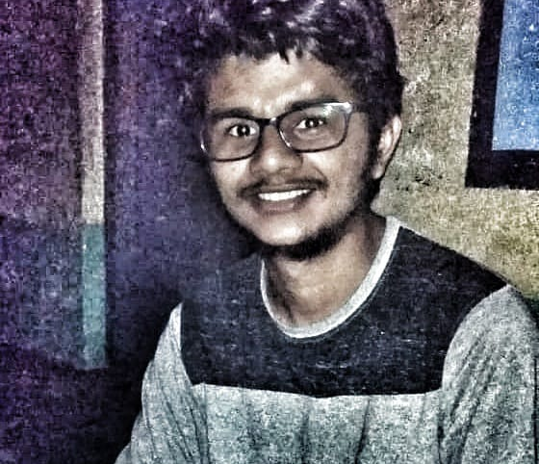
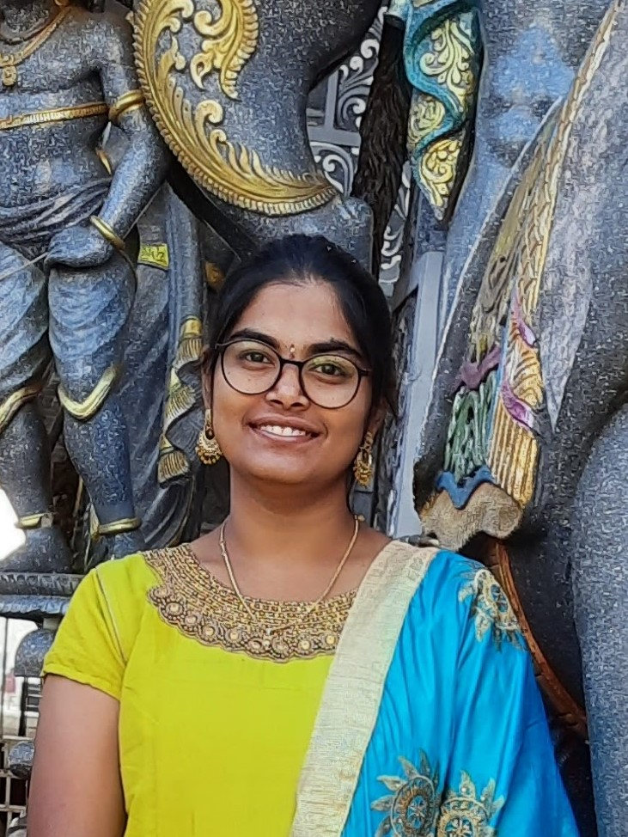
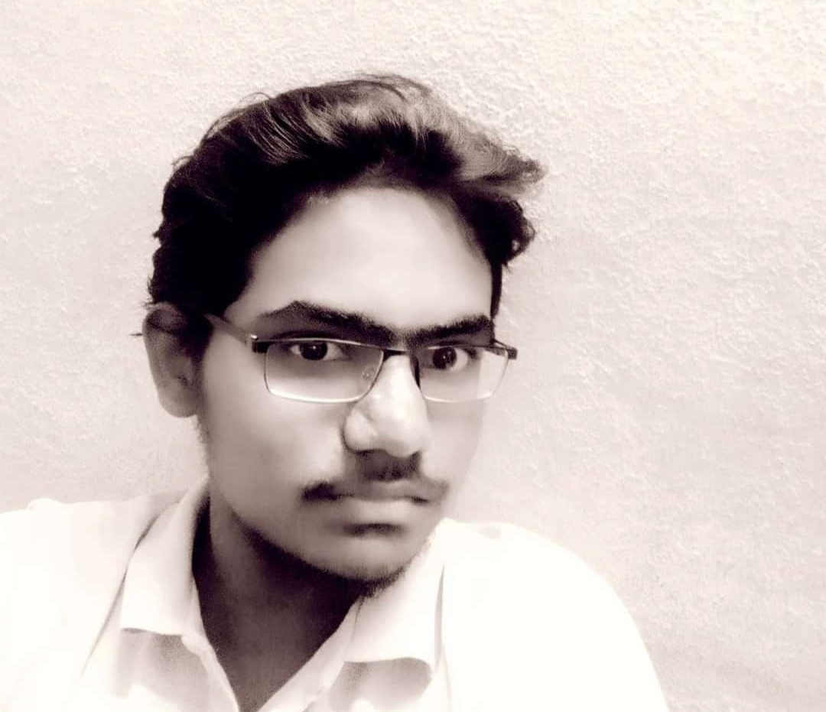

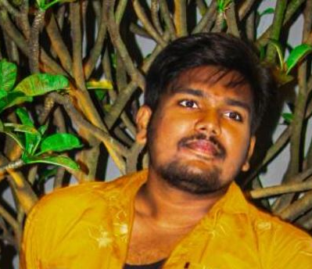
MEET OUR TEAM
.
Karre Yaswanth
FFEUID028842
Hima Sagar Janagama
FFEUID032644
G Sujan Kumar Reddy
FFEUID028794
Annapareddy Navya Sri
FFEUID020509
Karre Yaswanth
FFEUID028842
Purna Manikanta
FFEUID032647
.

Slide 13

CREDITS
Stakeholders Edunet Foundation FFE Scholars IBM india Pvt Ltd | Subject Matter Experts(SMEs) Khyati | Coaches Jahir Mohit Kumar

